Slide 1

Chapter 5 Applications of the Definite Integral (定积分的应用)
In this Chapter, we will know some important concepts.
Area Between Curves
Volume: Slicing, Disks, and Washers
Volumes by Cylindrical Shells
Arc Length and Surface Area
Probability

Slide 2
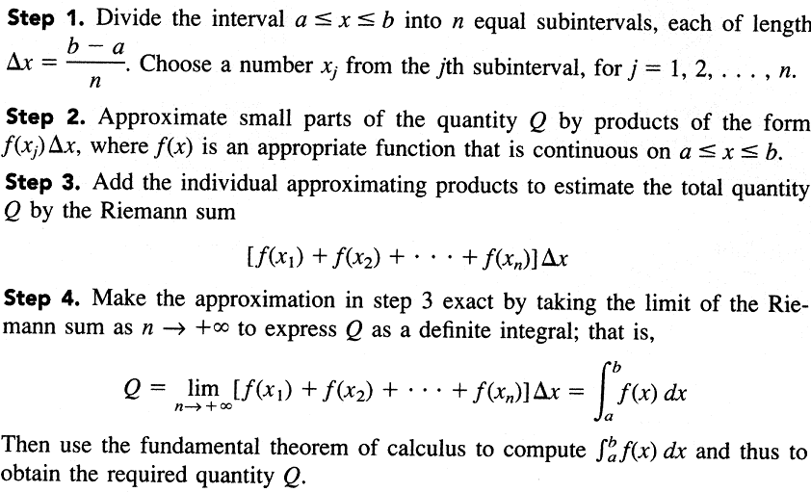
A Procedure for using Definite Integration in Applications

Slide 3
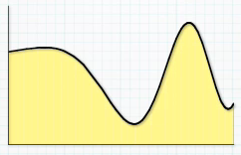
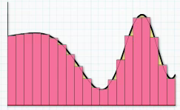
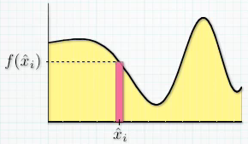




Slide 4
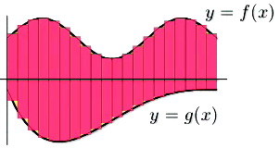
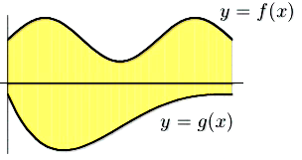

Slide 5
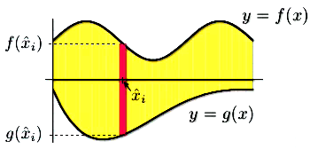

Bottom
curve
Top curve

Slide 6
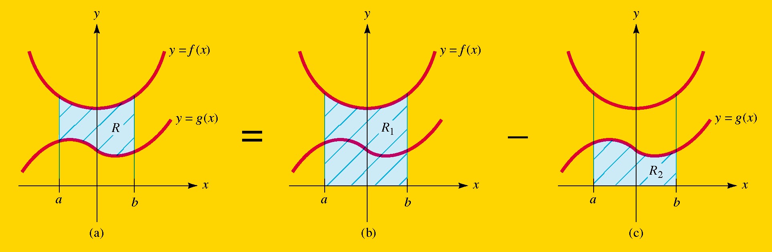
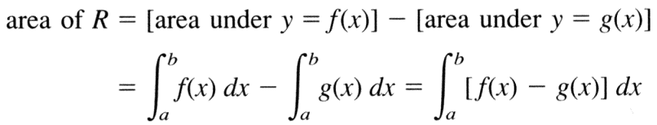
Section 5.1 Area Between Curves

Slide 7
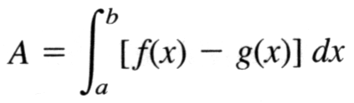
The Area Between Two Curve If f(x) and g(x) are continuous with f(x)≥g(x) on the interval a≤x≤ b, then the area A between the curves y=f(x) and y=g(x) over the interval is given by

Slide 8
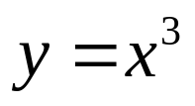
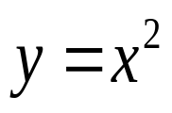
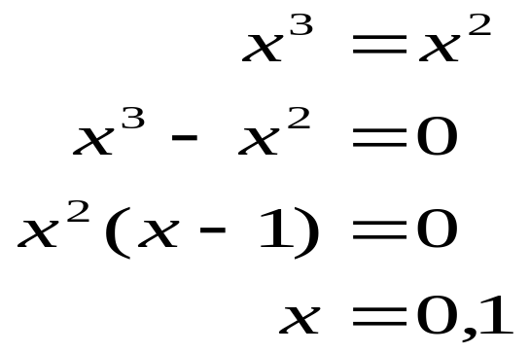
Example
Find the area of the region R enclosed by the curves
and
Solution:
To find the points where the curves intersect, solve the equations simultaneously as follows:
The corresponding points (0,0) and (1,1) are the only points of intersection.
to be continued

Slide 9

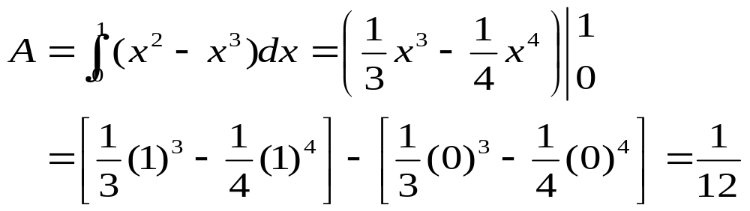
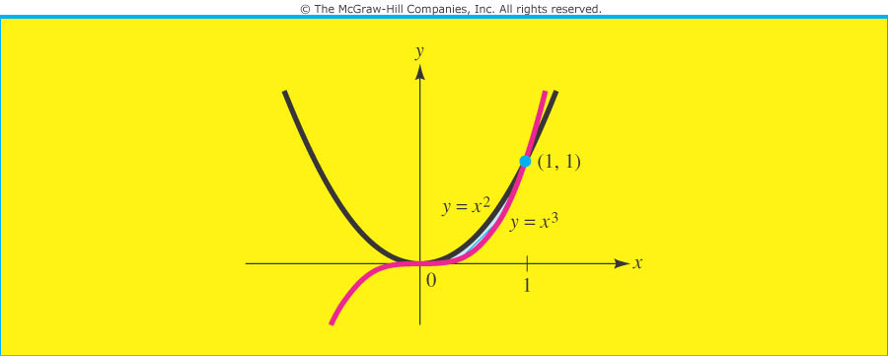
The region R enclosed by the two curves is bounded above by and below by , over the interval (See the Figure). The area of this region is given by the integral

Slide 10
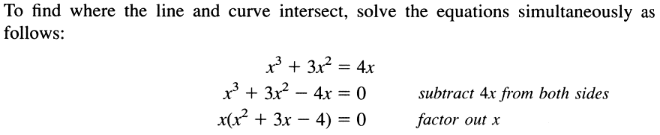
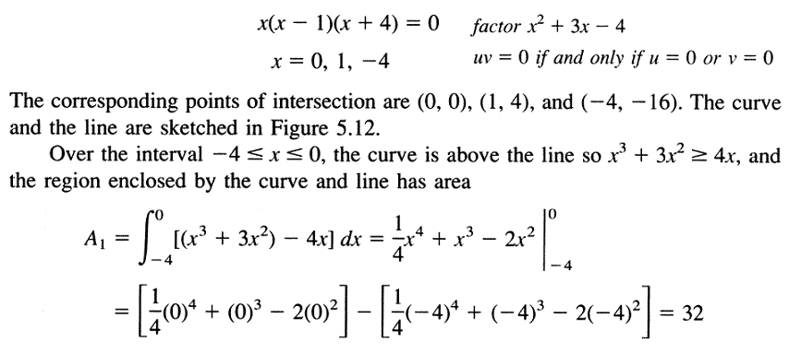
Example
Solution:
to be continued

Slide 11
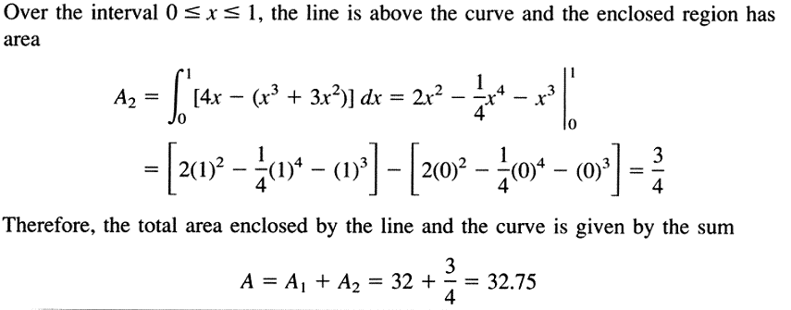
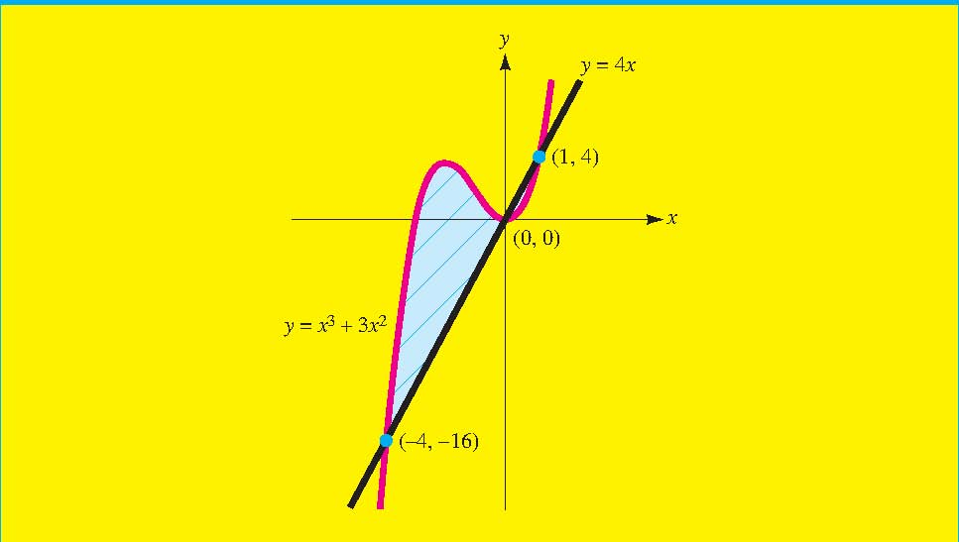

Slide 12


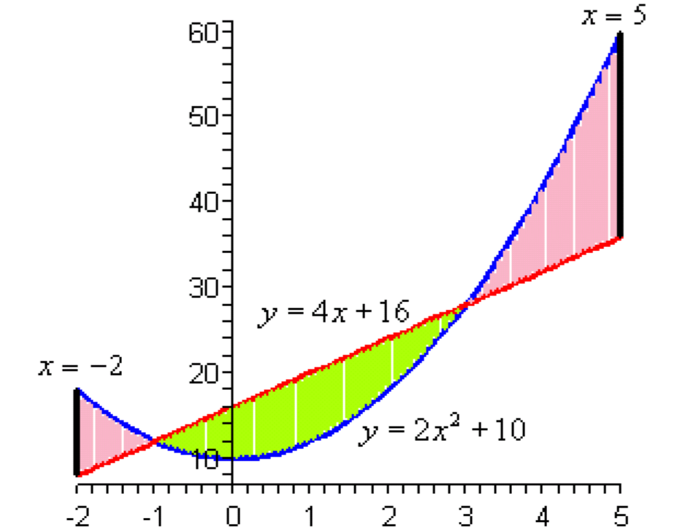



Example
Solution:
to be continued

Slide 13

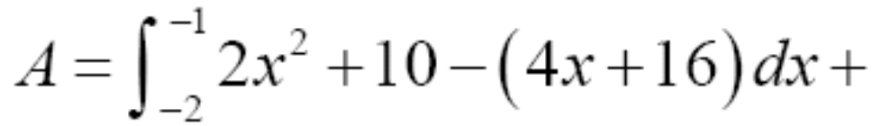
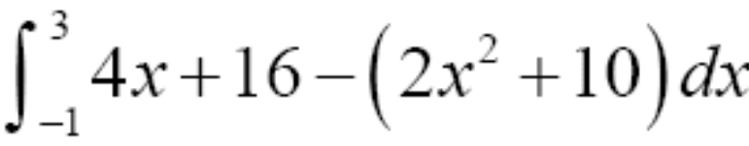
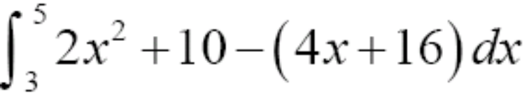

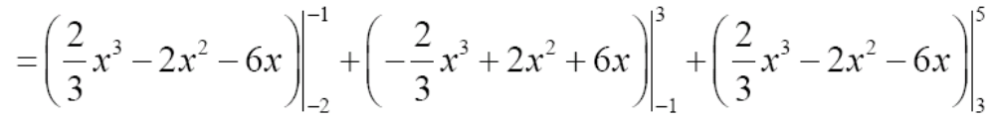
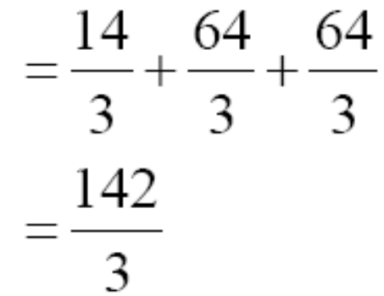

Slide 14
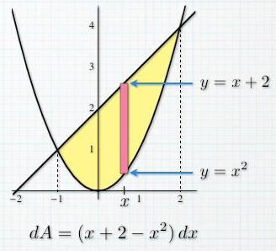
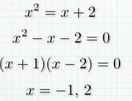
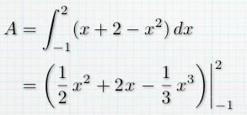

Example
Find the area of the region bounded by the graph of y=x² and y=x+2.
Solution:

Slide 15
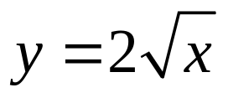
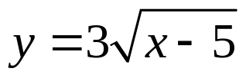
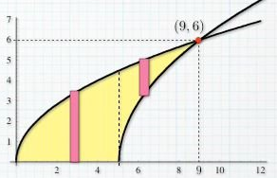
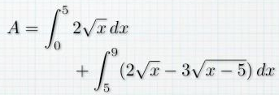

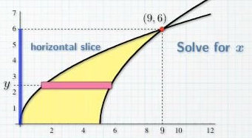

Example
Find the area of the region bounded by the graph of , y=0, and .
Solution:

Slide 16
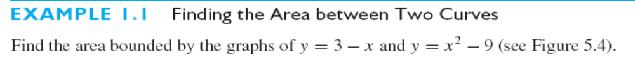

Slide 17

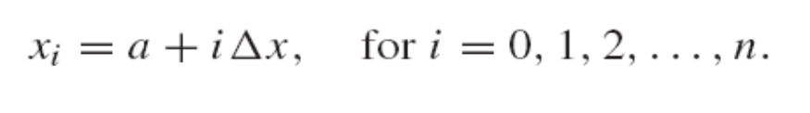
Section 5.2 Volume: Slicing, Disks and Washers
Volumes by Slicing
Cylinder (圆柱体): Any solid whose cross sections perpendicular to some axis running through the solid are all the same.
If either the cross-sectional area or width of a solid is not constant, we will need to modify our approach.
We start by partitioning the interval [a,b] on the x-axis into n subintervals, each of width △x=(b-a)/n. As usual, we denote and so on, so that

Slide 18
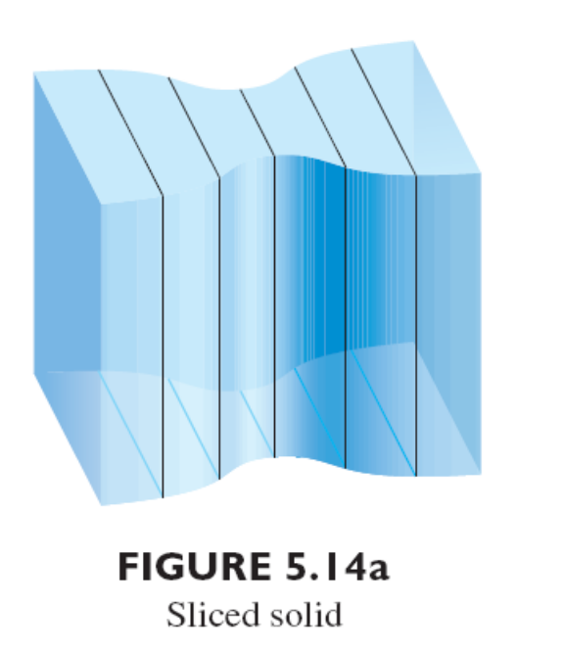
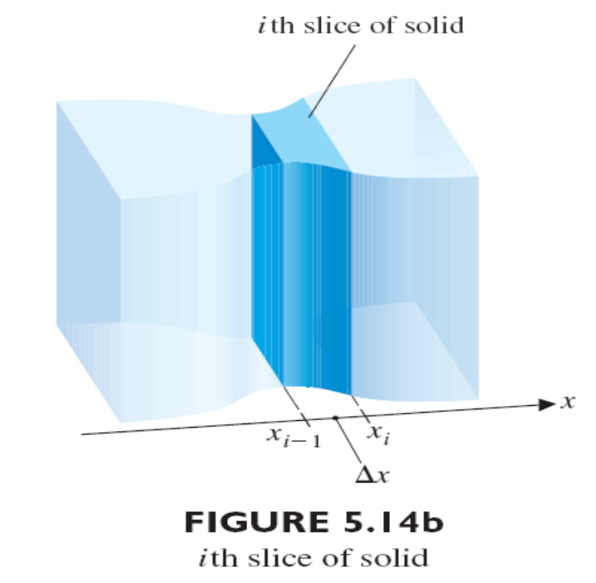
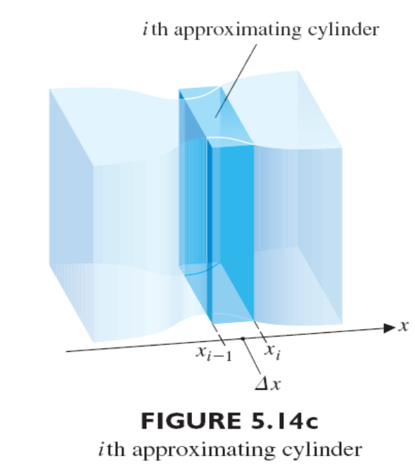
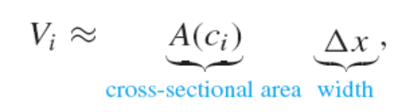
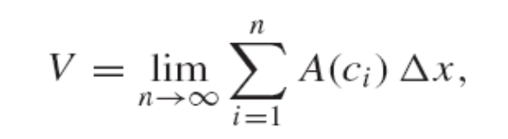
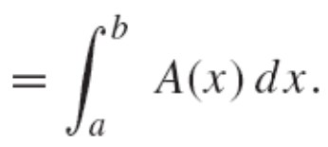
The Volume of the ith slice is given as following.
We get the exact volume by computing

Slide 19
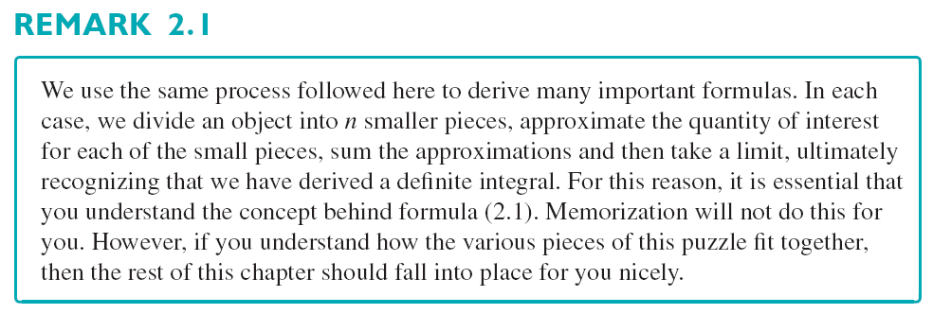

Slide 20
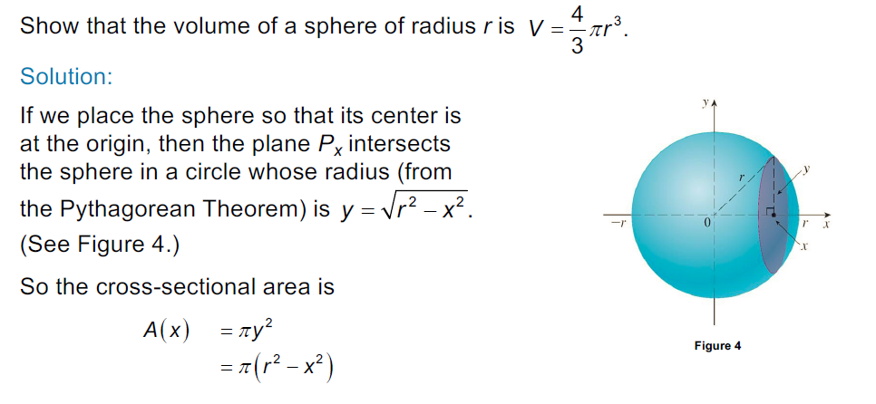
Example：

Slide 21
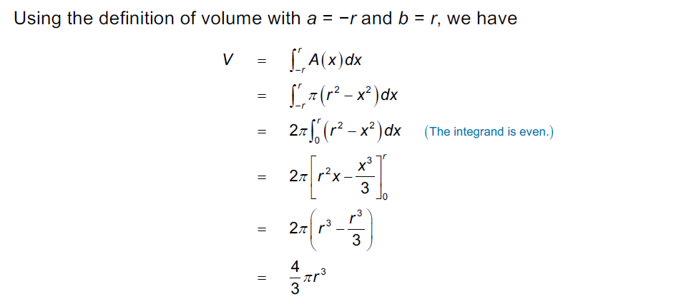

Slide 22
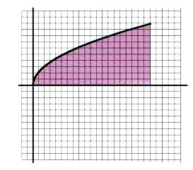
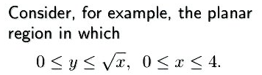

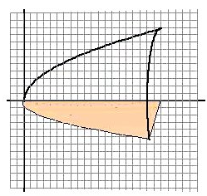
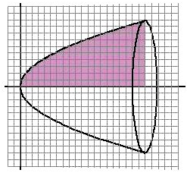
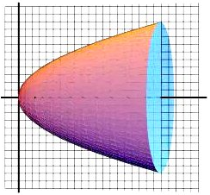
The Method of Disks: The volume of a Solid of Revolution (旋转体的体积)

Slide 23
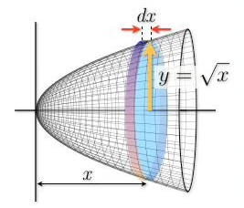



Cross-sections perpendicular to the
axis of rotation are circular
So a typical slice may be viewed as a thin disk
Solids with cross-sectional area A(x)
Divide the interval a≤x≤b into n equal
subintervals of length △x

Slide 24




The total volume V can be approximated by
The approximation improves as n increase without bound (△x approach 0) and

Slide 25



Slide 26

Volume Formula
Suppose f(x) is continuous and f(x) ≥0 and a≤x≤b and let R be the region under the curve y=f(x) between x=a and x=b. Then the solid S formed by revolving R about the x axis has volume

Slide 27


Example
Find the volume of the solid S formed by revolving the region under the curve from x=0 to x=2 about the x axis.

Slide 28


Solution:
The region, the solid of revolution, and the jth disk are shown in the Figure. The radius of the jth disk is . Hence,
and

Slide 29




Slide 30



Suppose that g(y) ≥0 and g is continuous on the interval [c,d]. Then revolving the region bounded by the curve x=g(y) and the y-axis, for c≤y≤d, about the y-axis generates a solid. The volume of the solid is then given by

Slide 31



Slide 32



The Method of Washers
One complication that occurs in computing volumes is that the solid may have a cavity or “hole” in it. Another occurs when a region is revolved about a line other than the x-axis or the y- axis.

Slide 33





Slide 34




Slide 35





Slide 36


Section 5.3 Volumes by Cylindrical Shells
In this section, we present an alternative to the method of washers discussed in section 5.2.
We consider the general case for a region revolved about y-axis. Let R denote the region bounded by the graph of y=f(x) and the x-axis on the interval [a,b], where 0<a<b and f(x) ≥0 on [a,b].

Slide 37








We first partition the closed interval [a,b] into n subintervals of equal width △x=(b-a)/n. On each subintervals , pick a point and construct the rectangle of height as indicated in Figure 5.29a. Revolving this rectangle about the y-axis forms a thin cylindrical shell.
Notice that the length of such a thin sheet corresponds to the circumference of the cylindrical shell, which is . So the volume of the ith cylindrical shell is approximately

Slide 38



The total volume V of the solid can then be approximated by the sum of the volumes of the n cylindrical shells:

Slide 39




Slide 40




Slide 41


Slide 42





Section 5.4 Arc Length and Surface Area (弧长和表面积)
Arc Length (弧长)
We begin by partitioning the interval [a,b] into n equal pieces:
, where , for each i=1,2,…,n. From the usual distance formula, we have

Slide 43







Since f is continuous on the subinterval and differentiable on . By the mean value theorem, we then have
for some number . This gives us the approximation

Slide 44




Slide 45


Surface Area (表面积)
We begin by partitioning the interval [a,b] into n equal pieces:
,
where , for each i=1,2,…,n.

Slide 46








The surface area of this frustum will give us an approximation to the actual surface area on the interval . First, observe that the slant height of this frustum is
We can apply the mean value theorem, to obtain
For some number . This give us

Slide 47






The surface area of that portion of the surface on the interval is approximately the surface area of the frustum of the cone,
Since if △x is small,
The total surface area S,

Slide 48




Slide 49

Section 5.7 Work (功)

Slide 50


Slide 51



Slide 52


Slide 53


Slide 54



Slide 55


Slide 56


Example：

